Slide 1


Bhoomi Baraiya
03/07/2022

Slide 2

Outline
Executive Summary
Introduction
Methodology
Results
Conclusion
Appendix

Slide 3
Executive Summary
Summary of methodologies
Data Collection through API
Data Collection with Web Scraping
Data Wrangling
Exploratory Data Analysis with SQL
Exploratory Data Analysis with Data Visualization
Interactive Visual Analytics with Folium
Machine Learning Prediction
Summary of all results
Exploratory Data Analysis result
Interactive analytics in screenshots
Predictive Analytics Result

Slide 4
Introduction
Project background and context
Space X advertises Falcon 9 rocket launches on its website with a cost of 62 million dollars; other providers cost upward of 165 million dollars each, much of the savings is because Space X can reuse the first stage. Therefore, if we can determine if the first stage will land, we can determine the cost of a launch. This information can be used if an alternate company wants to bid against space X for a rocket launch. This goal of the project is to create a machine learning pipeline to predict if the first stage will land successfully.
Problems you want to find answers
What factors determine if the rocket will land successfully?
The interaction amongst various features that determine the success rate of a successful landing.
What operating conditions needs to be in place to ensure a successful landing program

Slide 5


Slide 6
Methodology
Executive Summary
Data collection methodology:
The data was collected by the information of all the unsuccessful landings. Most unsuccessful landing were planned and controlled by the Space X.
Perform data wrangling
One hot encoding was applied to categorical features
Perform exploratory data analysis (EDA) using visualization and SQL
Perform interactive visual analytics using Folium and Plotly Dash
Perform predictive analysis using classification models

Slide 7
Data Collection
The Data collection was done using get request to the spaceX API.
Next, We decoded the response content as Json using .Jason() function call and turn it into a pandas dataframe.
Then the data was cleaned, checked for missing values and fill in the missing values.
The objective was to extract the launch records as HTML table, parse the table and convert it to a pandas datafram.

Slide 8
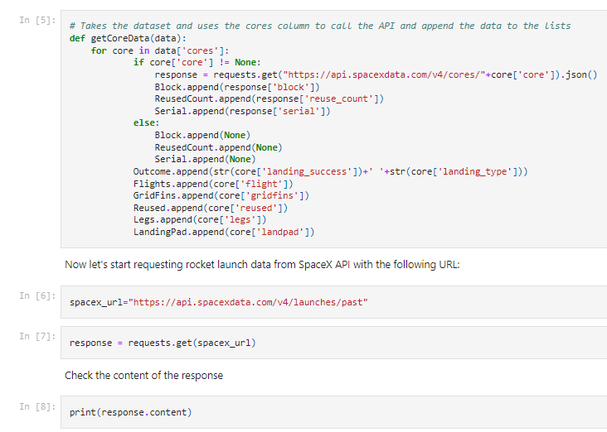
Data Collection – SpaceX API
Get request method is used to collect data, and for cleaning and did some basic wrangling and formatting.
The link to notebook is Data Collection With API.ipynb

Slide 9
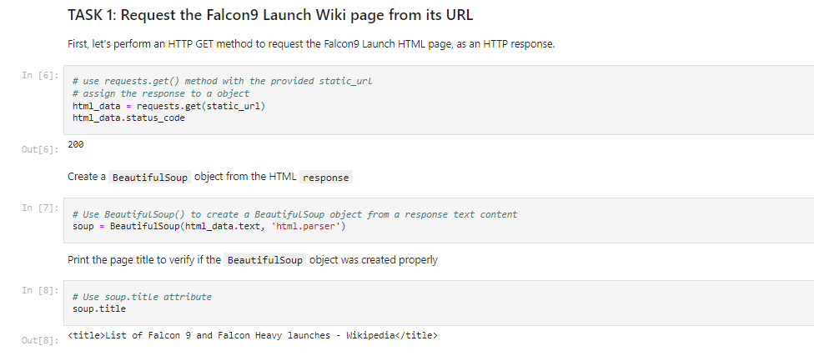
Data Collection - Scraping
Applying web scarping, we recorded web scrap Falcon 9 launch with BeautifulSoup.
We converted the table into dataframe.
The link to the notebook Data Collection Web Scraping

Slide 10
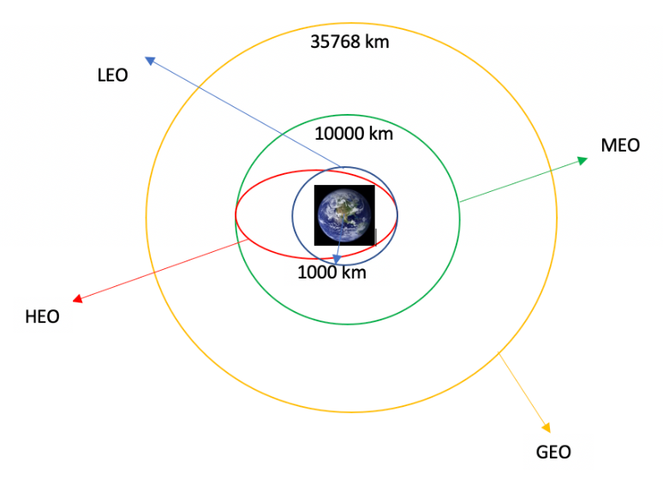
Data Wrangling
Performing exploratory data analysis, we determined the training labels.
Calculated the number of each slid and occurrence of each orbit.
The link to the notebook Data Wrangling

Slide 11
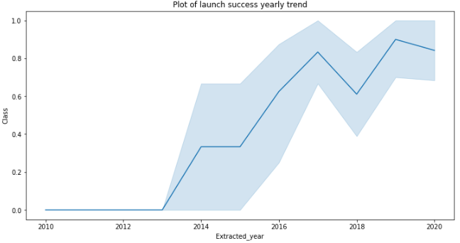
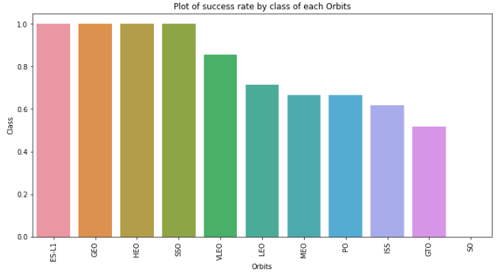
EDA with Data Visualization
Using data visualization, we explored the relationship between flight number and launch site, payload and launch site, success rate of each orbit type.
The link to the notebook EDA With Data Visualization

Slide 12
EDA with SQL
Loaded the SpaceX dataset into PostgreSQL database without leaving the jupyter notebook.
We applied EDA with SQL to get insight from the data. We wrote queries to find out for instance:
The names of unique launch sites in the space mission.
The total payload mass carried by boosters launched by NASA
The average payload mass carried by booster version F9 v1.1
The link to the notebook EDA with SQL

Slide 13
Build an Interactive Map with Folium
We marked all launch sites, and added map objects such as markers, circles, lines to mark the success or failure of launches for each site on the folium map.
We assigned the feature launch outcomes to class 0 and 1.
Using the color-labeled marker clucters, we identified which launch sites have relatively high success rate.
The link to the notebook Interactive Map with Folium

Slide 14
Build a Dashboard with Plotly Dash
We built an interactive dashboard with Plotly dash
We plotted pi charts showing total launched by a certain sites
We plotted scatter graph showing the relationship with outcomes and payload mass for the different booster version
The link to the notebook Dashboard with Plotly Dash

Slide 15
Predictive Analysis (Classification)
We loaded data using numpy and pandas, transformed the data, split our data into training and testing.
We built different machine leanring models and tune different hyperparameters using GridSearchCV.
The link to the notebook Predictive Analysis

Slide 16
Results
Exploratory data analysis results
Interactive analytics demo in screenshots
Predictive analysis results

Slide 17

Section 2

Slide 18
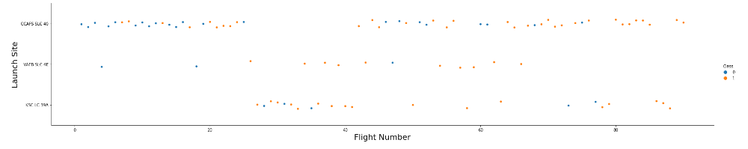
Flight Number vs. Launch Site
The larger the flight amount at launch site, the greater the success rate at launch site.

Slide 19
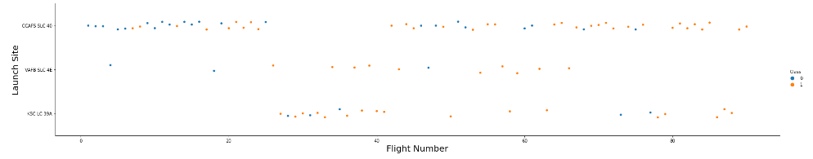
Payload vs. Launch Site
The greater the payload mass, the higher the success rate

Slide 20
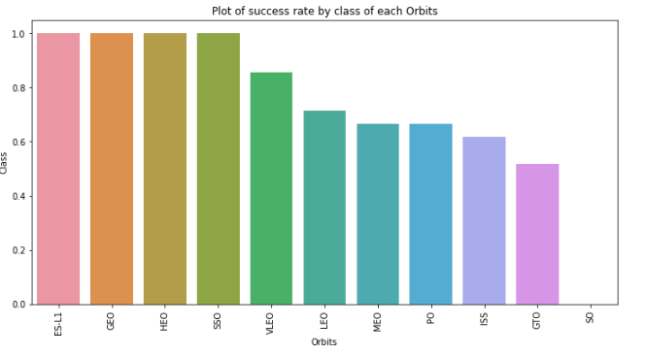
Success Rate vs. Orbit Type
ES-L1, GEO, HEO, SSO, VLEO had the most success rate.

Slide 21
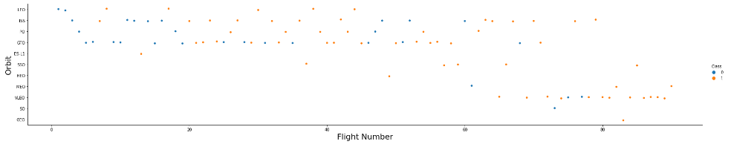
Flight Number vs. Orbit Type
In the LEO orbit, success is related to the number of flights whereas in the GTO orbit, there is no relationship between flight number and the orbit.

Slide 22
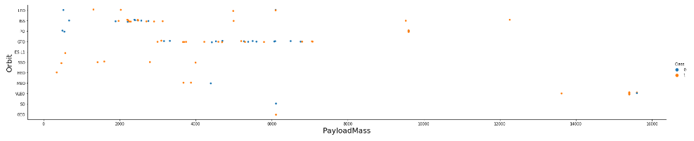
Payload vs. Orbit Type
With heavy payloads, the successful landing are more for PO, LEO and ISS orbits.

Slide 23
Launch Success Yearly Trend
The success rate since 2013 kept on increasing till 2020.

Slide 24
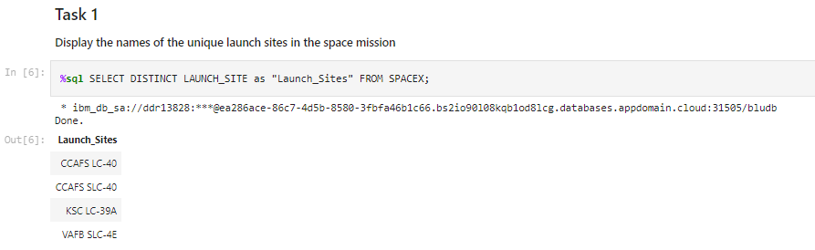
All Launch Site Names
We used the DISTINCT keyword to get the unique launch sites

Slide 25
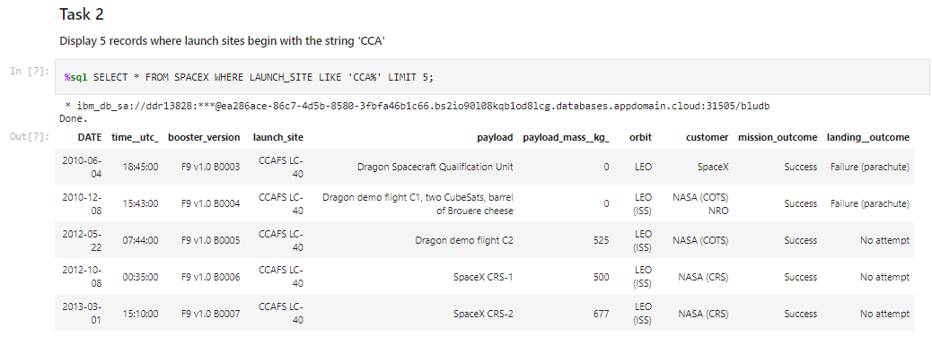
Launch Site Names Begin with 'CCA'
We used the below query to get the launch sites name begin with CCA

Slide 26
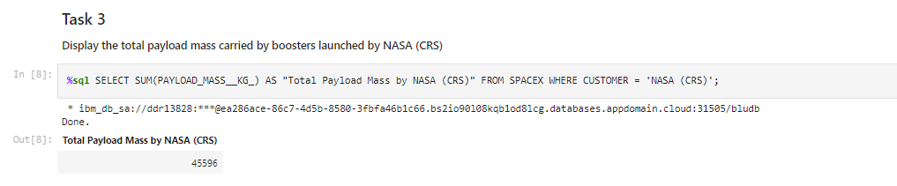
Total Payload Mass
We used where clause to get the total payload mass carried by the booster launches

Slide 27
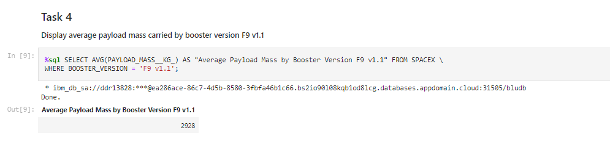
Average Payload Mass by F9 v1.1
We used where clause in BOOSTER_VERSION to get the payload mass by F9 v1.1

Slide 28
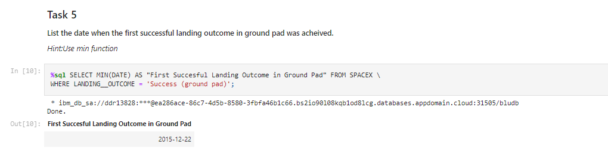
First Successful Ground Landing Date
We used where clause with landing_outcome to get the first successful landing outcome in ground pad

Slide 29
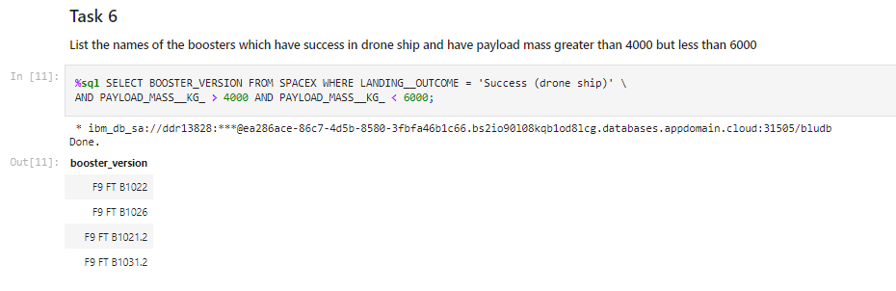
Successful Drone Ship Landing with Payload between 4000 and 6000
We used AND condition in PAYLOAD_MASS_KG to get he payload between 4000 and 6000

Slide 30
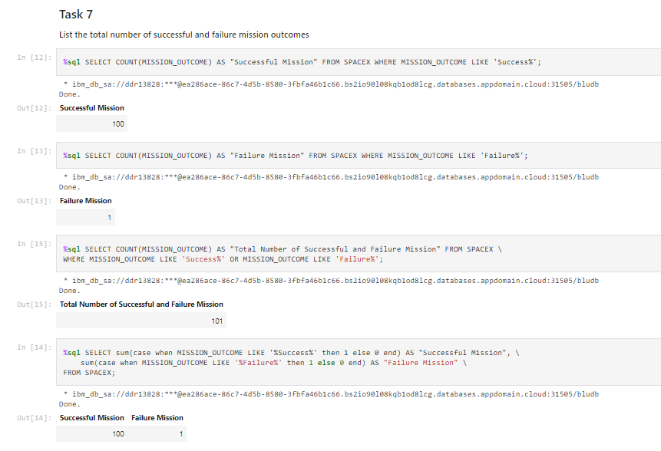
Total Number of Successful and Failure Mission Outcomes
We used where clause with MISSION_OUTCOME to get the number of successful and failure missions

Slide 31
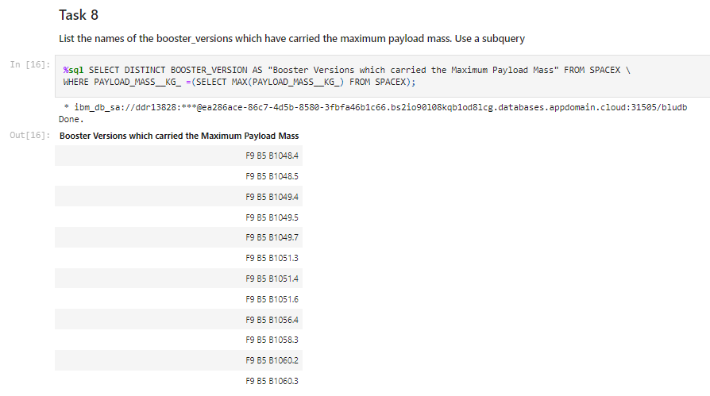
Boosters Carried Maximum Payload
We used WHERE clause with PAYLOAD_MASS_KG and inline nested select function to get the maximum payload.

Slide 32
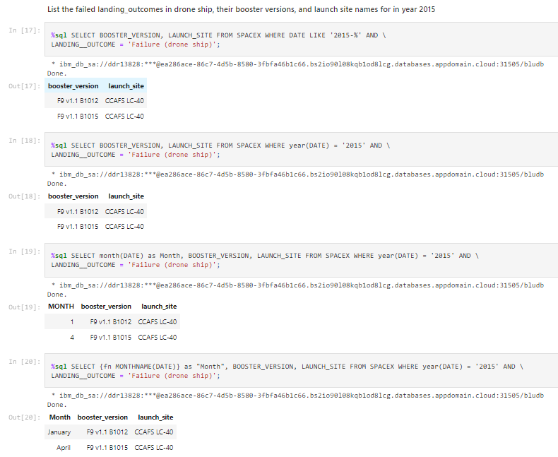
2015 Launch Records
We used WHERE and LIKE clause in LAUNCH_OUTCOME to get the launch records.

Slide 33
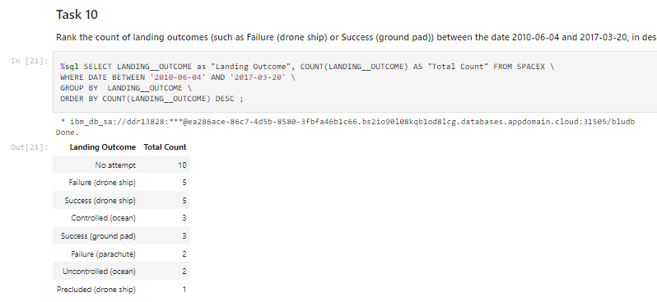
Rank Landing Outcomes Between 2010-06-04 and 2017-03-20
We used WHERE clause with DATE and GROUP BY with LANDING_OUTCOME and ORDER BY to get the landing outcome between 2010-06-04 and 2017-03-20.

Slide 34

Section 3

Slide 35
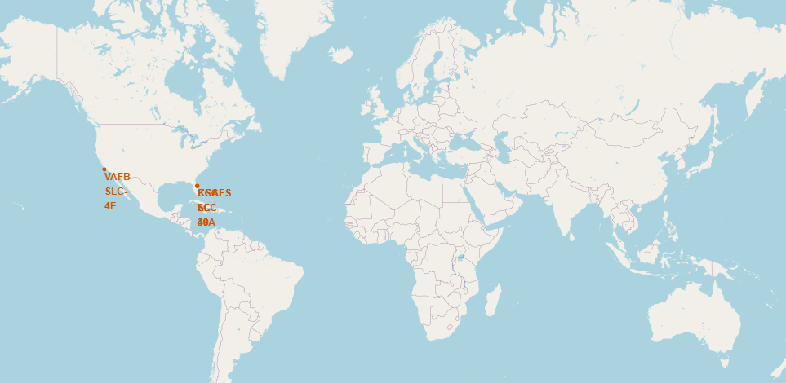
All Launch Sites Global map marker

Slide 36
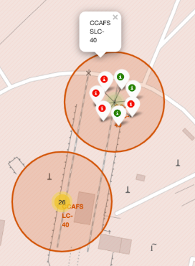
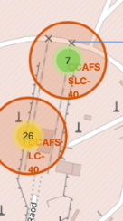
Markers showing launch sites with color labels

Slide 37
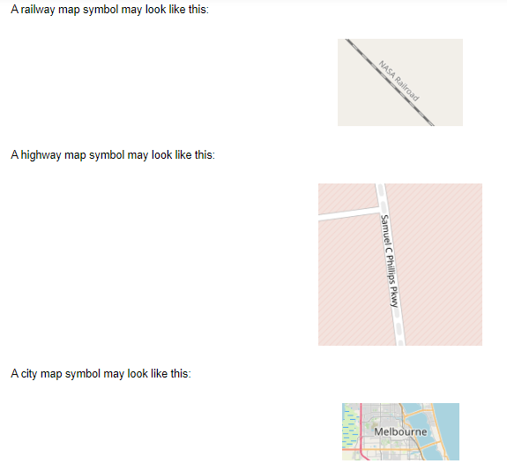
Map symbols

Slide 38

Section 4

Slide 39
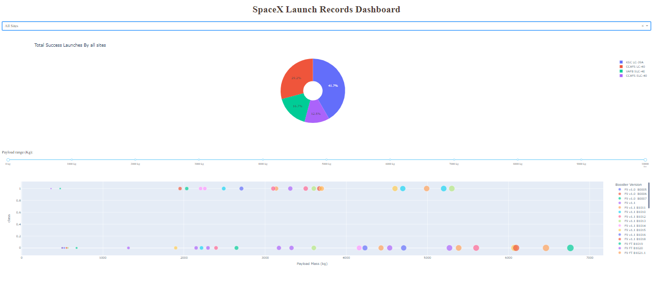
Pie chart showing the success percentage achieved by each launch site

Slide 40
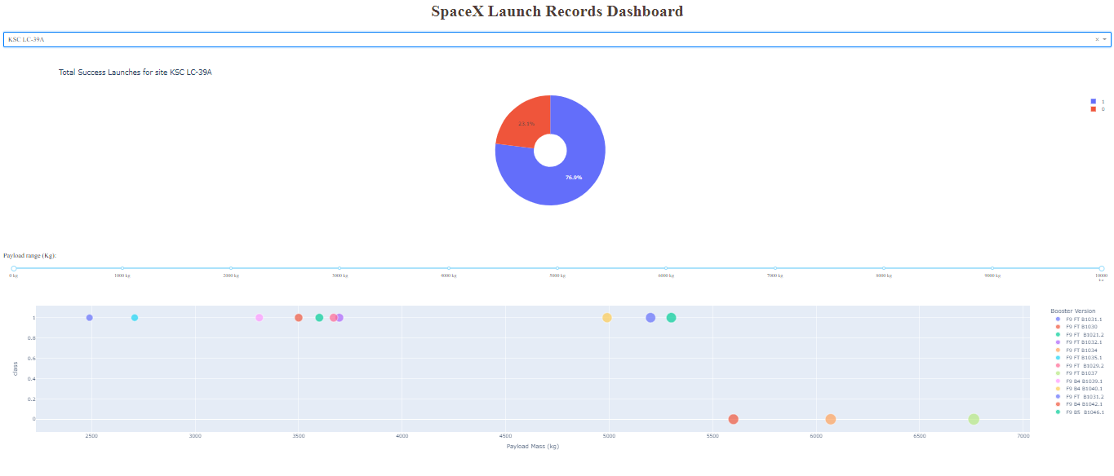
Pie chart showing the Launch site with the highest launch success ratio

Slide 41
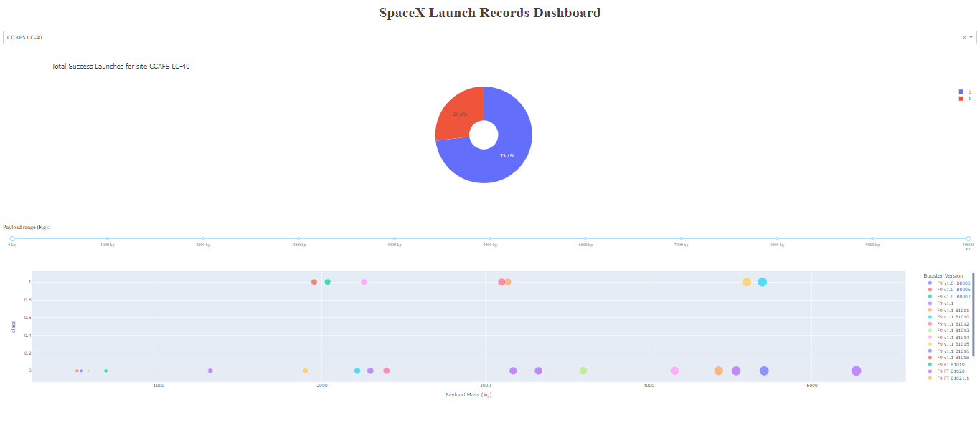
Scatter plot of Payload vs Launch Outcome for all sites, with different payload selected in the range slider

Slide 42

Section 5

Slide 43
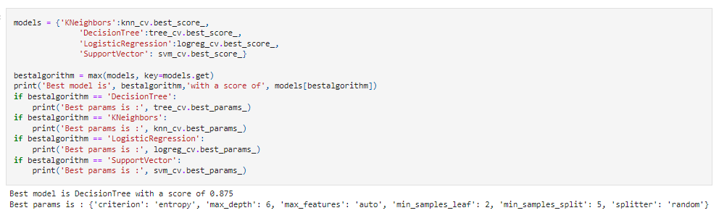
Classification Accuracy
The decision tree classifier provides highest classification accuracy

Slide 44
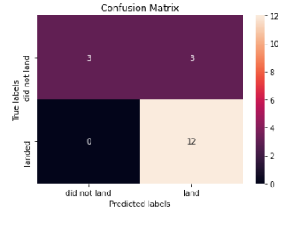
Confusion Matrix
The confusion matrix for the decision tree classifier shows that the classifier can distinguish between the different classes. The major problem is the false positives.

Slide 45
Conclusions
We concluded that…
The success rate depends upon the flight amount at launch site.
Launch success rate started to increase in 2013 till 2020.
Orbits ES-L1, GEO, HEP, SSO, VLEO had the most success rate.
KCS LC-39A had the most successful launches of any sites.
The decision tree classifier is the best machine learning algorithm for the task.

Slide 46
Appendix
Include any relevant assets like Python code snippets, SQL queries, charts, Notebook outputs, or data sets that you may have created during this project

Slide 47


